Slide 1
Discrete Choice Modeling
0 Introduction
1 Summary
2 Binary Choice
3 Panel Data
4 Bivariate Probit
5 Ordered Choice
6 Count Data
7 Multinomial Choice
8 Nested Logit
9 Heterogeneity
10 Latent Class
11 Mixed Logit
12 Stated Preference
13 Hybrid Choice
14. Spatial Data
15. Aggregate Market Data
William Greene
Stern School of Business
New York University

Slide 2
Aggregate Data and Multinomial Choice: The Model of Berry, Levinsohn and Pakes

Slide 3
Resources
Automobile Prices in Market Equilibrium, S. Berry, J. Levinsohn, A. Pakes, Econometrica, 63, 4, 1995, 841-890. (BLP)
http://people.stern.nyu.edu/wgreene/Econometrics/BLP.pdf
A Practitioner’s Guide to Estimation of Random-Coefficients Logit Models of Demand, A. Nevo, Journal of Economics and Management Strategy, 9, 4, 2000, 513-548
http://people.stern.nyu.edu/wgreene/Econometrics/Nevo-BLP.pdf
A New Computational Algorithm for Random Coefficients Model with Aggregate-level Data, Jinyoung Lee, UCLA Economics, Dissertation, 2011
http://people.stern.nyu.edu/wgreene/Econometrics/Lee-BLP.pdf
Elasticities of Market Shares and Social Health Insurance Choice in Germany: A Dynamic Panel Data Approach, M. Tamm et al., Health Economics, 16, 2007, 243-256.
http://people.stern.nyu.edu/wgreene/Econometrics/Tamm.pdf

Slide 4


Slide 5


Slide 6
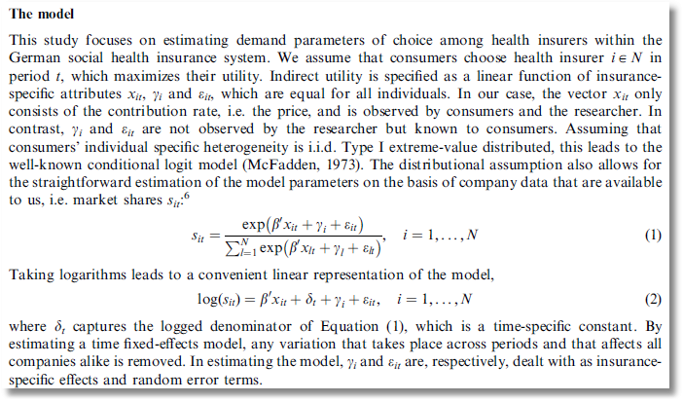

Slide 7
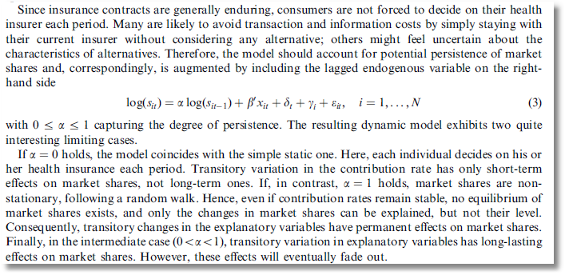

Slide 8
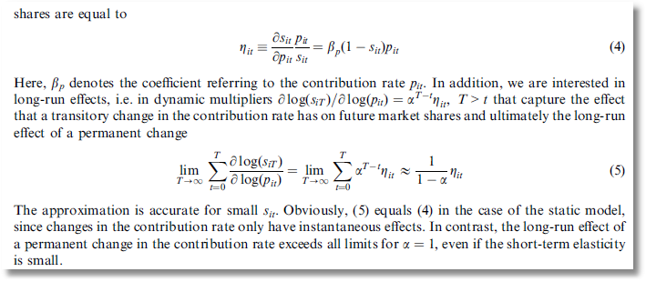

Slide 9
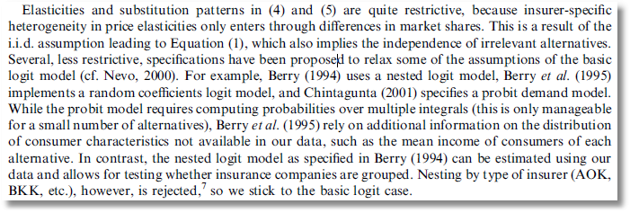

Slide 10
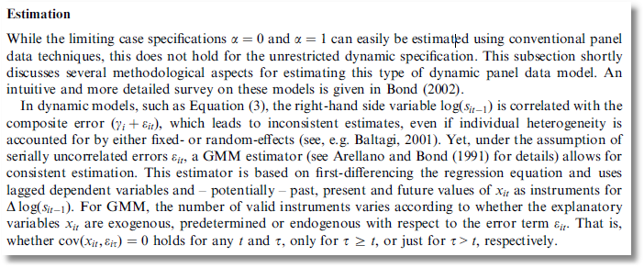
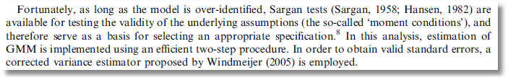

Slide 11
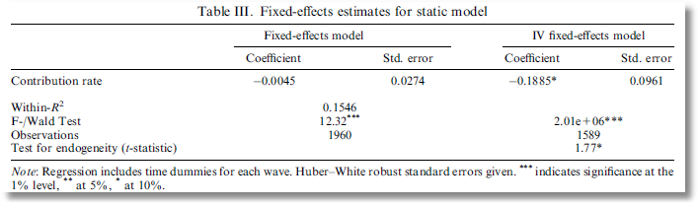
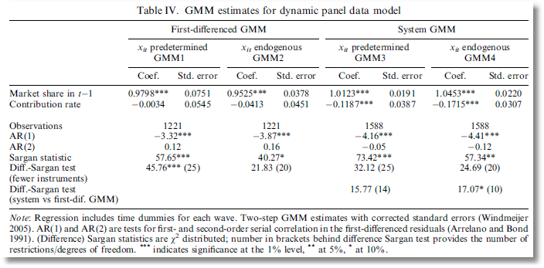

Slide 12
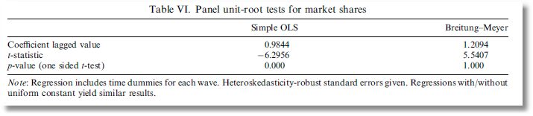
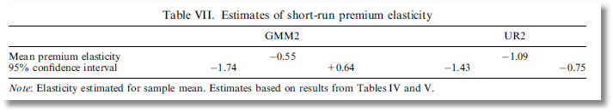
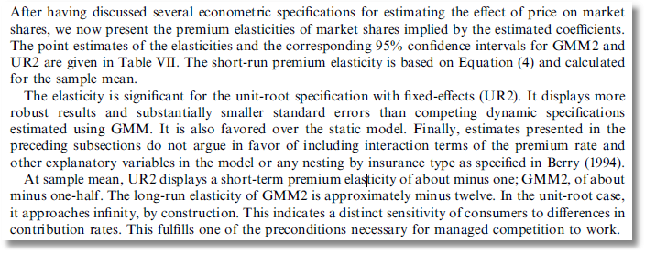

Slide 13
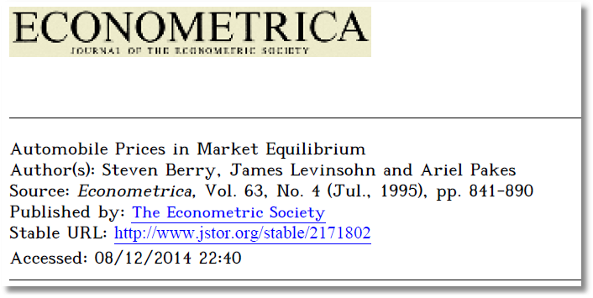
Aggregate Data and Multinomial Choice: The Model of Berry, Levinsohn and Pakes

Slide 14
Theoretical Foundation
Consumer market for J differentiated brands of a good
j =1,…, J_{t} brands or types
i = 1,…, N consumers
t = i,…,T “markets” (like panel data)
Consumer i’s utility for brand j (in market t) depends on
p = price
x = observable attributes
f = unobserved attributes
w = unobserved heterogeneity across consumers
ε = idiosyncratic aspects of consumer preferences
Observed data consist of aggregate choices, prices and features of the brands.

Slide 15
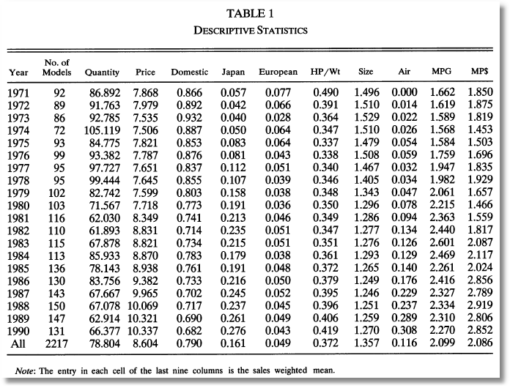
BLP Automobile Market
J_{t}
t

Slide 16
Random Utility Model
Utility: U_{ijt}=U(w_{i},p_{jt},x_{jt},f_{jt}|θ), i = 1,…,(large)N, j=1,…,J
w_{i} = individual heterogeneity; time (market) invariant. w has a continuous distribution across the population.
p_{jt}, x_{jt}, f_{jt}, = price, observed attributes, unobserved features of brand j; all may vary through time (across markets)
Revealed Preference: Choice j provides maximum utility
Across the population, given market t, set of prices p_{t} and features (X_{t},f_{t}), there is a set of values of w_{i} that induces choice j, for each j=1,…,J_{t}; then, s_{j}(p_{t},X_{t},f_{t}|θ) is the market share of brand j in market t.
There is an outside good that attracts a nonnegligible market share, j=0. Therefore,

Slide 17
Functional Form
(Assume one market for now so drop “’t.”) U_{ij}=U(w_{i},p_{j},x_{j},f_{j}|θ)= x_{j}'β – αp_{j} + f_{j} + ε_{ij} = δ_{j} + ε_{ij}
E_{consumers i}[ε_{ij}] = 0, δ_{j} is E[Utility].
Will assume logit form to make integration unnecessary. The expectation has a closed form.

Slide 18
Heterogeneity
Assumptions so far imply IIA. Cross price elasticities depend only on market shares.
Individual heterogeneity: Random parameters
U_{ij}=U(w_{i},p_{j},x_{j},f_{j}|θ_{i})= x_{j}'β_{i} – αp_{j} + f_{j} + ε_{ij}
β_{ik} = β_{k} + σ_{k}v_{ik}.
The mixed model only imposes IIA for a particular consumer, but not for the market as a whole.

Slide 19
Endogenous Prices: Demand side
U_{ij}=U(w_{i},p_{j},x_{j},f_{j}|θ)= x_{j}'β_{i} – αp_{j} + f_{j} + ε_{ij}
f_{j} is unobserved
Utility responds to the unobserved f_{j}
Price p_{j} is partly determined by features f_{j}.
In a choice model based on observables, price is correlated with the unobservables that determine the observed choices.

Slide 20
Endogenous Price: Supply Side
There are a small number of competitors in this market
Price is determined by firms that maximize profits given the features of its products and its competitors.
mc_{j} = g(observed cost characteristics c, unobserved cost characteristics h)
At equilibrium, for a profit maximizing firm that produces one product, s_{j} + (p_{j}-mc_{j})∂s_{j}/∂p_{j} = 0
Market share depends on unobserved cost characteristics as well as unobserved demand characteristics, and price is correlated with both.

Slide 21
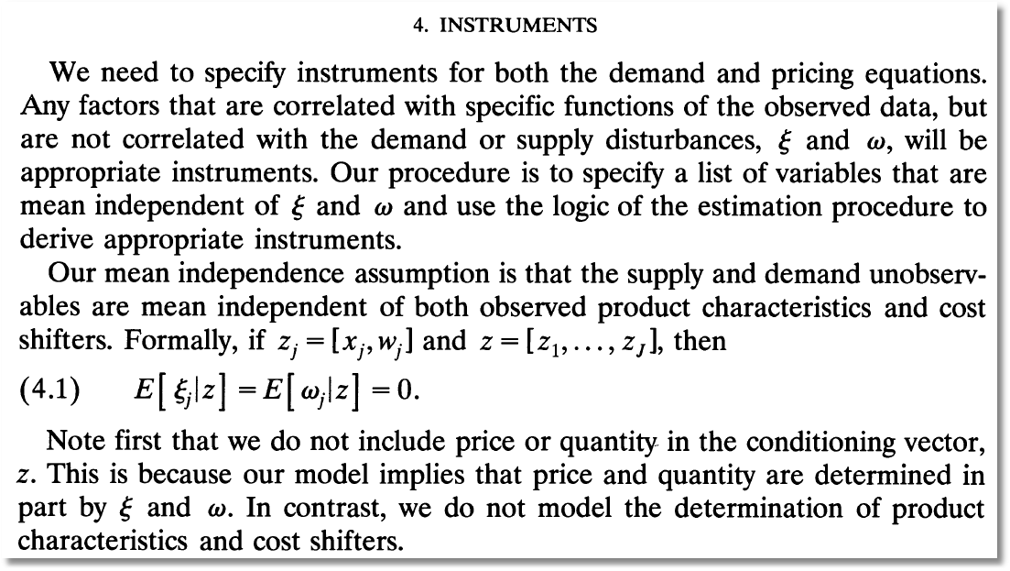
Instrumental Variables (ξ and ω are our h and f.)

Slide 22
Econometrics: Essential Components

Slide 23
Econometrics

Slide 24
GMM Estimation Strategy - 1

Slide 25
GMM Estimation Strategy - 2

Slide 26
BLP Iteration

Slide 27

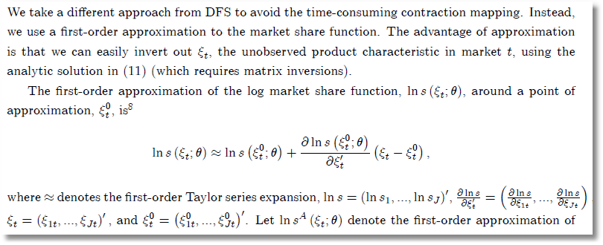
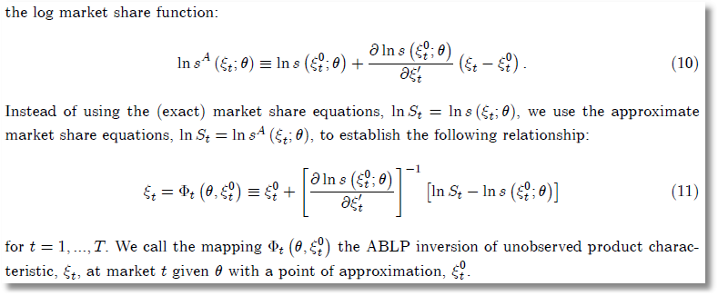
ABLP Iteration
ξ_{t} is
our f_{t}.
θ is our
(β,Σ)
No superscript is our (M); superscript 0 is our (M-1).

Slide 28
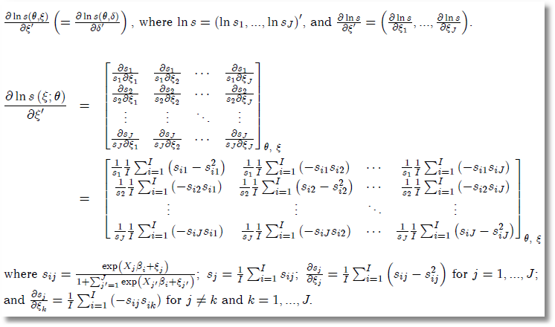
Side Results

Slide 29
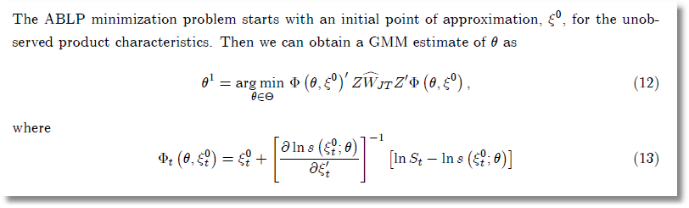
ABLP Iterative Estimator

Slide 30
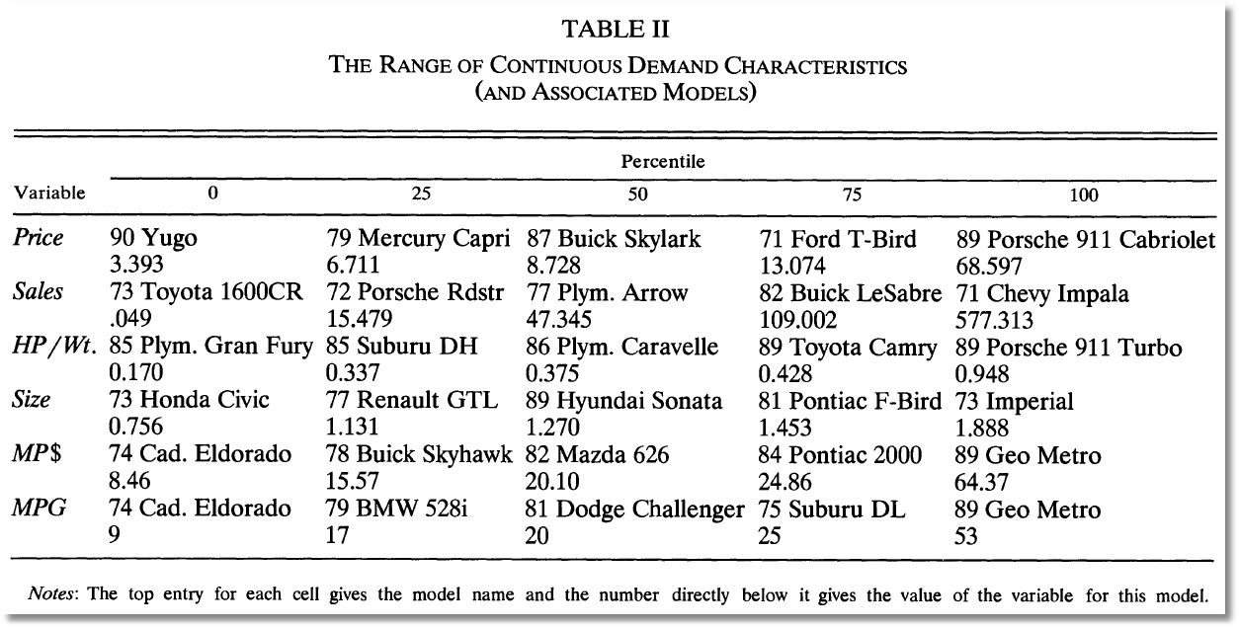
BLP Design Data

Slide 31
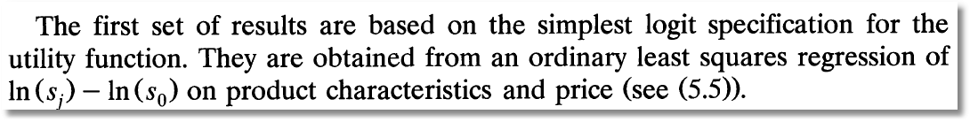
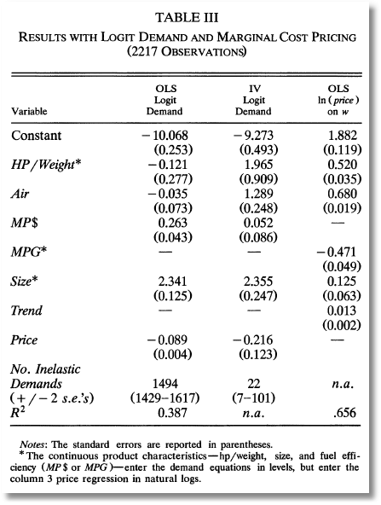
Exogenous price and nonrandom parameters

Slide 32
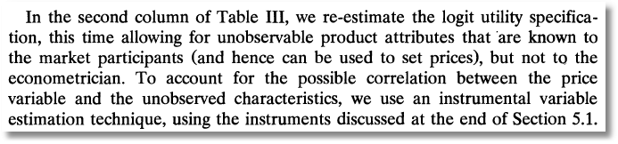
IV Estimation

Slide 33
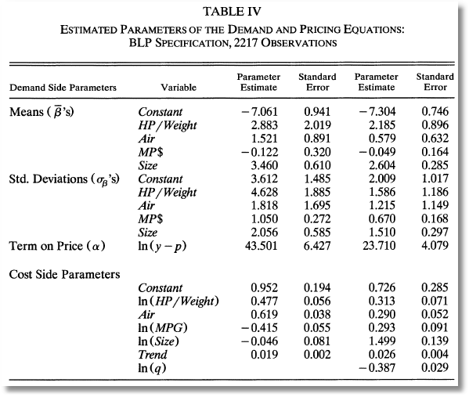
Full Model

Slide 34
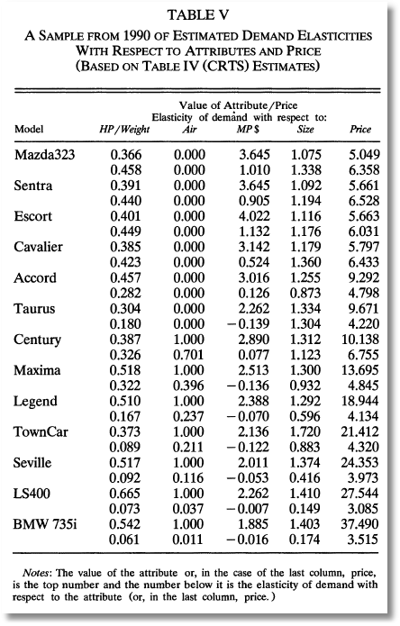
Some Elasticities

